Slide 1


pro-gram-ming
providing a sequence of instructions to perform a process
Who are programmers?
Only people who
Are good in math
Speak a computer language
Have advanced education
Spend all their time on a computer
Work in cubicles
Nonsense! I work from home.
Notes:
Define programming. What does that actually mean?
Review some stereotypes

Slide 2

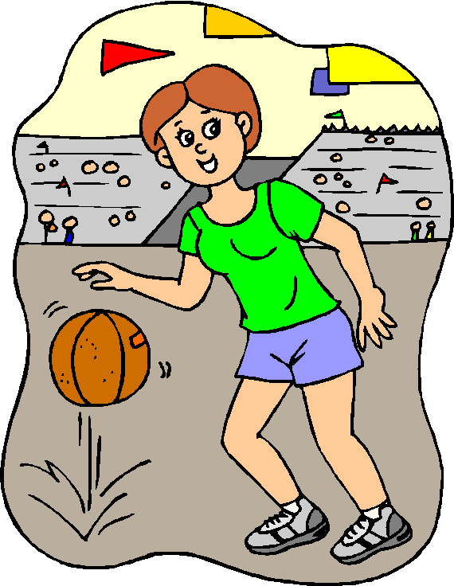
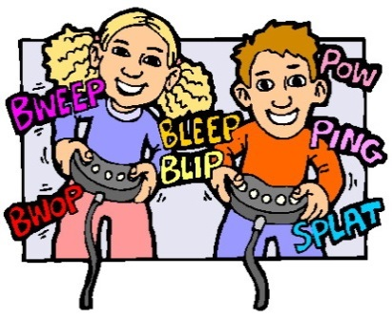
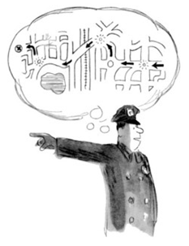
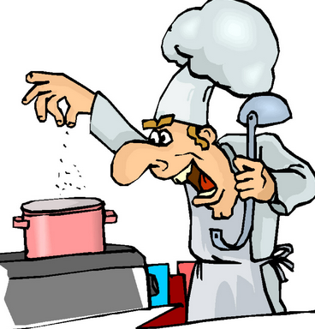
Showed a friend how to beat a level?
Followed a recipe to cook your favorite dish?
Taught someone how to play a sport?
Have you ever…
Given directions to
someone?
You might be
a programmer!
Notes:
Make the connection between providing instructions and programming.
We are all programmers

Slide 3
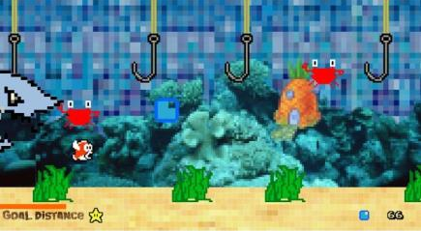
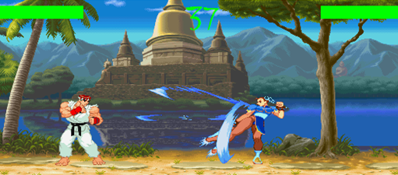
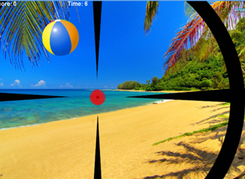
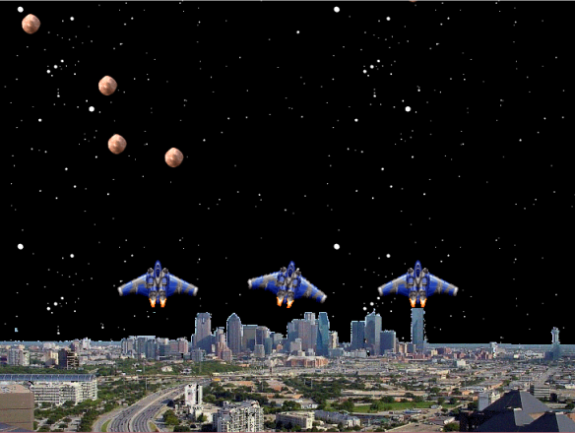
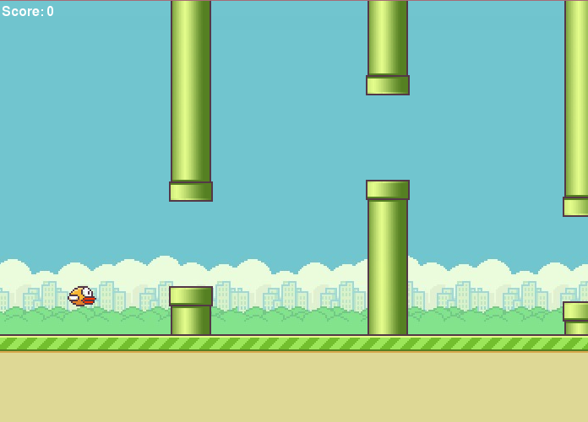
Smash Bug! Web based video game
Let’s Play!
Notes:
1) These are some of the games produced by our students

Slide 4
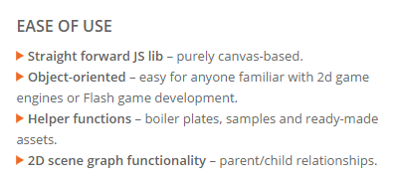

Game Engines
Most video games are developed using an engine. A game engine provides objects and functionality to help programmers design and create games. The TreSensa Game Engine (TGE) is a fast javascript game engine optimized for HTML5 development.
VROOM! Lets get this engine started.
Notes:
There are many web based game engines such as Phaser, Construct 2 and Kiwi.js
Once you learn one engine, learning different engines becomes easier.

Slide 5
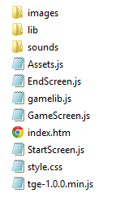
Resources
Our web based game, Smash Bugs! consists of media files, a HTML 5 file, CSS file, the TreSensa Game Engine (TGE) and supporting javascripts files.
Let’s keep it simple and get started.
Notes:
Have participants open the Smash Bug folder.
These are the files needed to create the game.
Write on the board media files, HTML file, css, TreSensa files and supporting js files.
Folder contains CodeExample.js – sample of code introduced throughout the presentation. In case a participant has trouble typing the code or falls behind.
Folder contains GameScreen – Complete.js . This is the completed example in case a participant has difficulties completed the game.

Slide 6
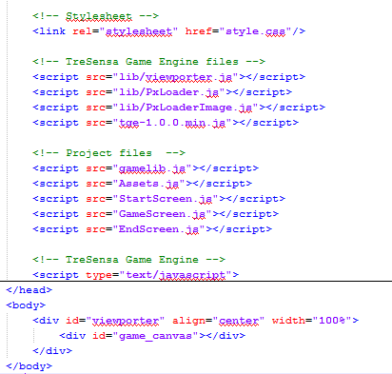
HTML
HTML file loads the TreSensa Game Engine, supporting javascript files and creates the canvas
What happen to the media?
Notes:
Open index.htm in Notepad++
Point out the reference to the css file, TreSensa Files, Project js files and canvas.
What’s missing? Use the list on the board from the previous slide.
Have participants click on index.htm. It double click on index.htm.
Tell participants to leave it open. We will be refreshing the page often as we add code.

Slide 7
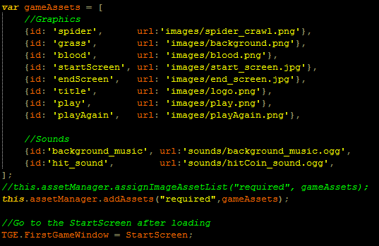
Assets.js
Assets.js makes media files available by associating each file with an “id” and designates which js file will be the First Game Window.
Let’s get to the game!
Notes:
Have participants open Asset.js in Notepad++
Here is where we load media files
Point out these images and sound files located in folders
Media files are given an id in order to use them later

Slide 8
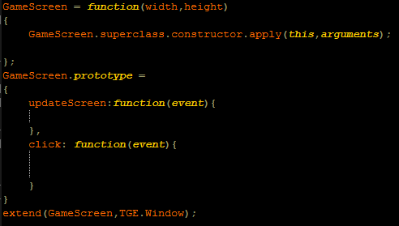

GameScreen.js
GameScreen.js is the main file that hosts the logic of the game. StartScreen.js and EndScreen.js will be discussed later.
Setup game objects
Behaviors
What game objects!
Notes:
Have participants open GameScreen.js in Notepad++
This is where our game code will live.
Point out the two sections
Setup and Behaviors

Slide 9
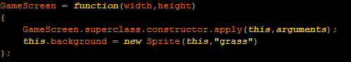
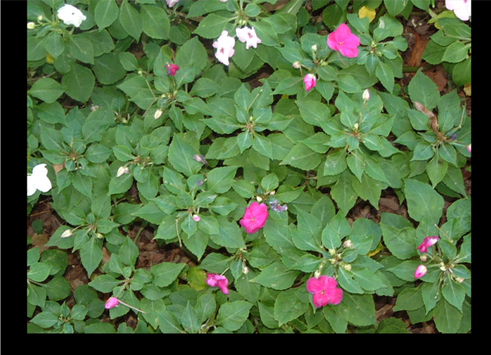
Sprite Object
Sprite object allows the programmer to use static images. First image to program is a background image.
Variable to represent the background
Sprite object
id of the grass.png from Assets.js
What other media can we create?
Notes:
First to element to add is a background image.
We add still images by creating a sprite variable.
Point out the variable, sprite object and the id of the grass.
Have participants enter the code. Refresh index.htm and notice the grass appears.

Slide 10
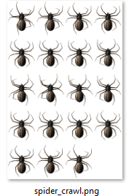
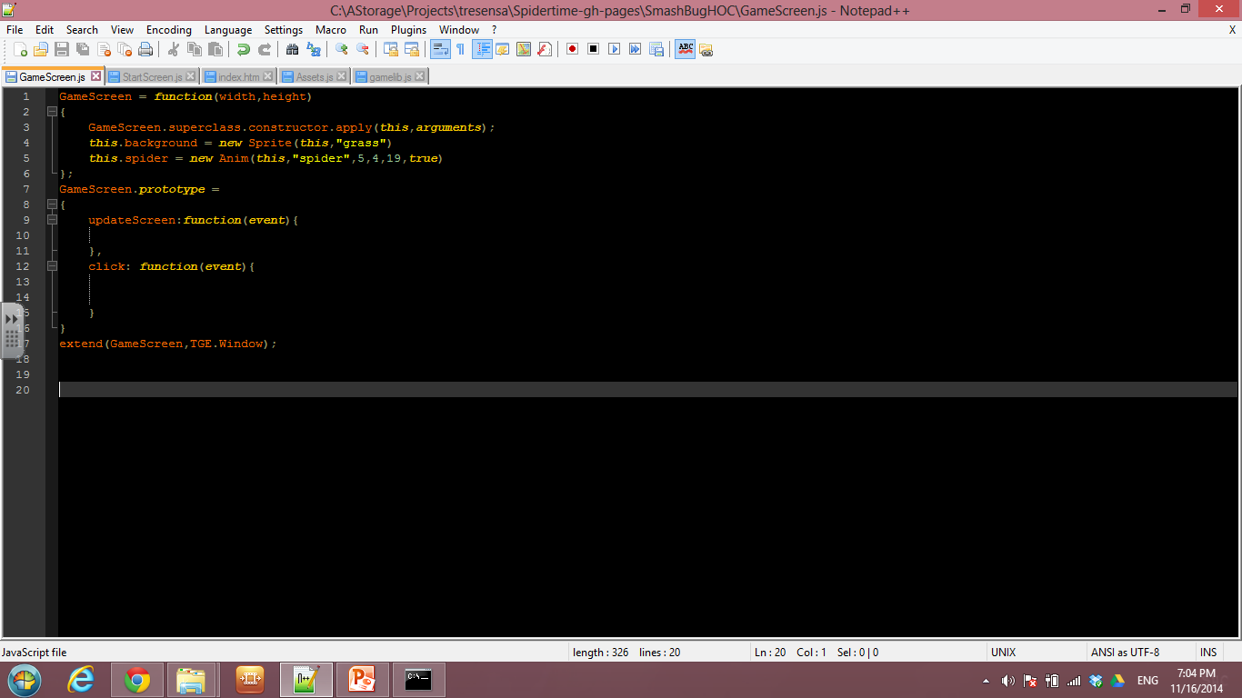
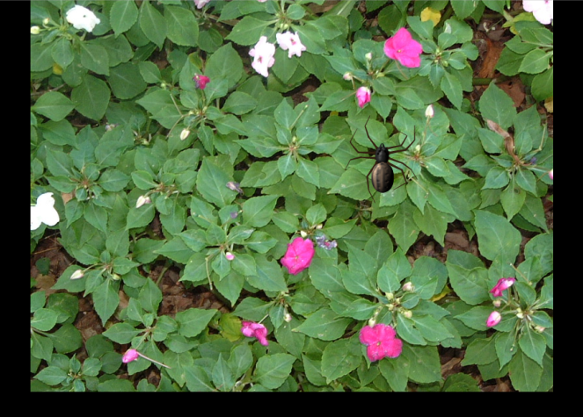
Anim Object
Anim object allows the programmer to use animated images. Animated images are typically supplied on sprites sheets. When creating an Anim object you have to provide the rows, columns and number of frames in the sprite sheet.
Variable to represent the animated spider
Anim object
id of spritesheet
Rows, columns, and frames
true is to add behaviors
Why is the spider not moving?
Notes:
Now we are ready to add another image. This image though is animated.
Animated images are typically provided via a spritesheet.
Have participants enter the code.
Point out the parameters: id, rows, columns, frames and true
Refresh index.htm and notice the animated spider.
Hmm….spider is not moving. We will solve this in the next slide.

Slide 11
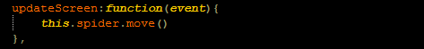
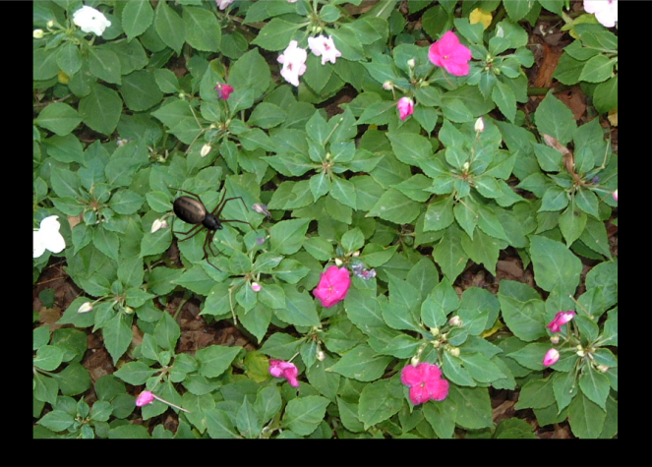
Behaviors
Behaviors are code segments the program executes when an event happens. updateScreen event is a common place for making objects move. Another useful event is click. We will use the click event later.
All objects have a simple list of commands.
Game updates the screen several times a second. Any code located in updateScreen will execute.
Let’s keep track of how many times we smash the bug.
Notes:
Programs only do what they are told.
Lets tell the spider to move.
Have participants enter the code. Refresh index.htm. Watch the spider move!

Slide 12
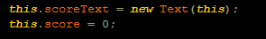
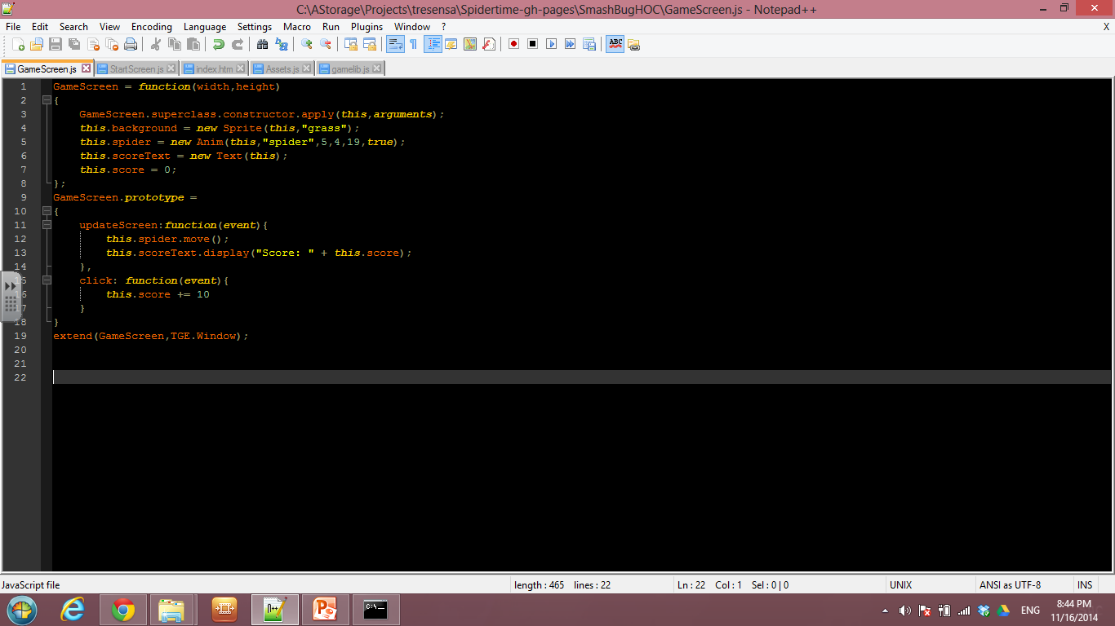
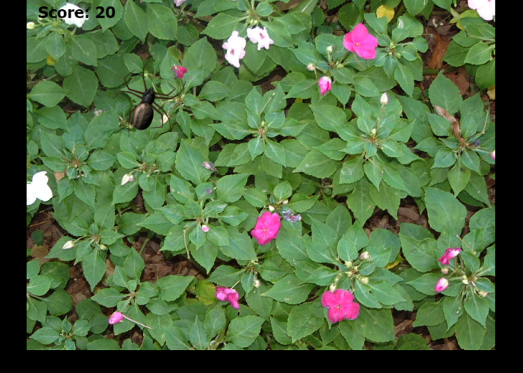
Text Object & Score
Text object allows the programmer to display textual information such as score.
Variables can store numerical information as well as objects.
Display the score when the game updates.
Increase the score when the player clicks on the spider.
Don’t bugs go SPLAT! when you smash them.
Notes:
Lets incorporate a way of keeping track of how many times we have clicked on the spider.
Similar to Sprite and Anim, we must create a variable to represent the score text.
We also need a variable to simply store the score
Have participants add the setup and update screen code
Refresh index.htm. Notice the score displays but nothing happens when we click on the spider.
We have to tell the program to increase the score when we click on the spider.
Have participants add the code to the click behavior.
Refresh index.htm. Observe the score increases when we click on the spider.
Lets make the spider go splat.

Slide 13
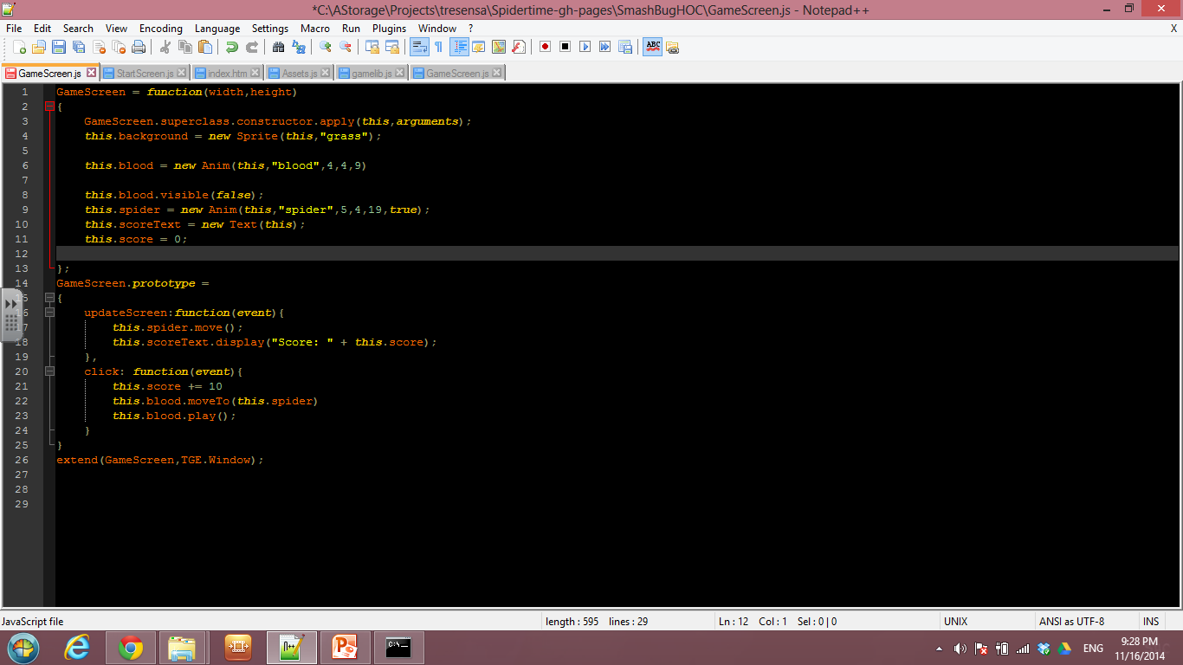
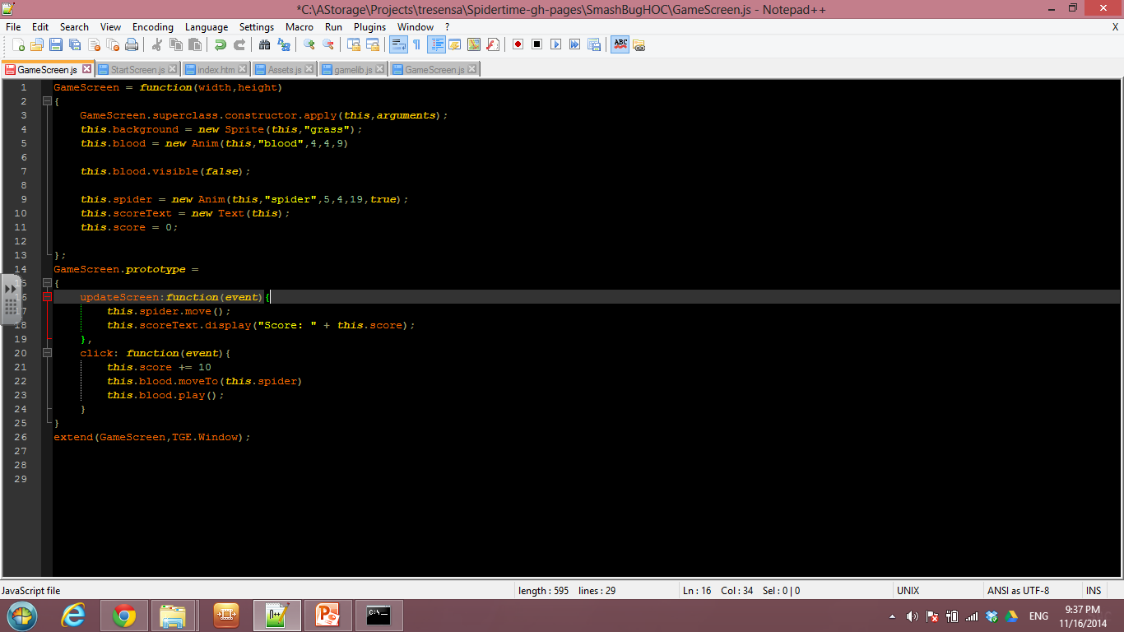

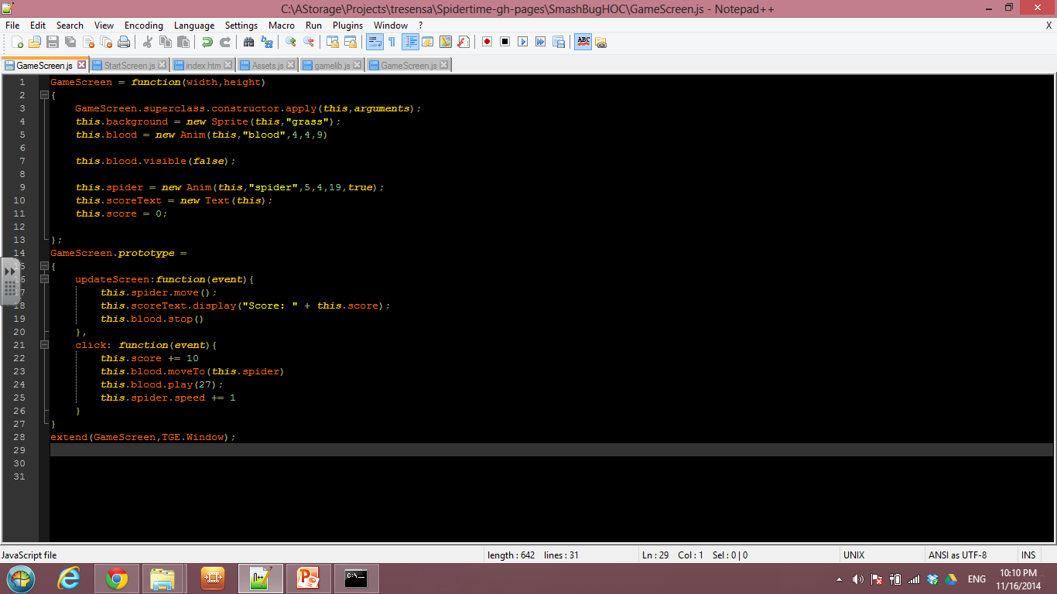
SPLAT!
Create another variable to store the Anim object of blood. Write the code before the spider variable in order to have the blood appear under the spider.
By default animations are visible which is not the desired outcome for the blood.
Make the blood animation play at the spider’s location when you click on it.
Blood animation needs to be stop or else it will continue playing.
I can smash spiders all day. I need a challenge.
Notes:
Have participants add a new Anim variable for the blood.
Refresh index.htm. Notice the blood is visible when the game starts. Not what we want.
Add code to make the blood not visible. Refresh index.htm. The blood is not visible. What should we do next?
Add code to move the blood to where we clicked on the spider and play the animation.
Refresh index.htm. Notice that the blood appears when we click on the spider. Are there any issues? Blood continues to animate.
Lets stop the blood animation in the update behavior

Slide 14
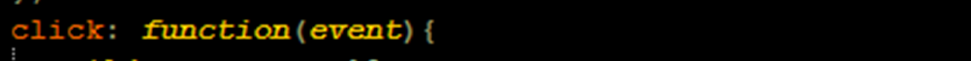
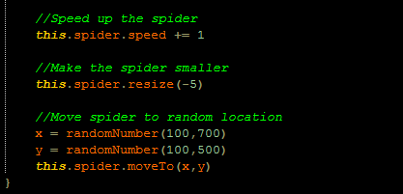
Increased Challenge
Games quickly lose their interest if they don’t progressively present the player with harder challenges. Here are a few examples of increased challenges.
Does this game ever end?
Notes:
We have to provide a challenge to the game.
What are some things we can add to our game to make it harder to click on the spider? Illicit response from participants.
We have offered some suggestions. Faster spider, make spider smaller, and make the spider appear in at a random location.
To speed up the workshop have all participants copy the code from CodeExample.js. This is Slide 14 – Increased Challenge
Refresh index.htm. Play! Notice it is starting to feel like a game but what is missing?
We need a goal / objective.

Slide 15
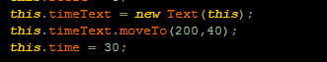
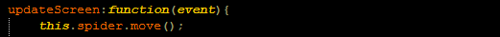
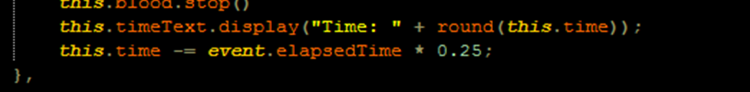
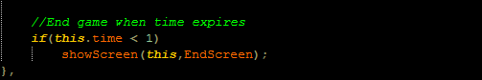
End Game
We could add a time component to the game so that the goal of the game becomes how many times you can smash the spider within 30 seconds.
Lets put the finishing touches on Smash Bug!
Notes:
Objective of the game will be to smash the spider as much as you can within 30 seconds.
Similar to score, we need to create a Text variable and a variable to store the time. Set the time to how long you want the game to run.
In the update, we need to adjust and display the time.
Have participants copy the code from CodeExample.js. This is Slide 15 – End Game
Refresh index.htm. Notice the time decreasing.
What missing? What should happen next?
Add the decision to the show the End Screen

Slide 16
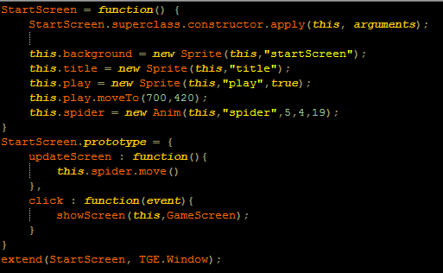
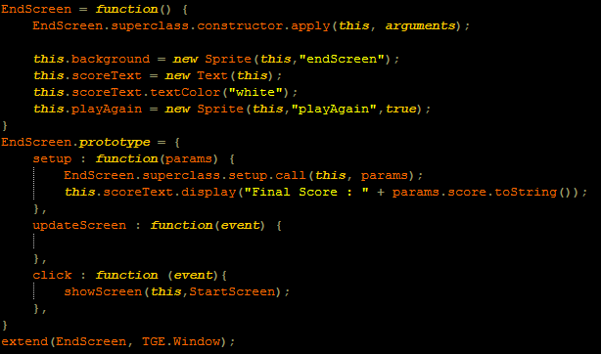
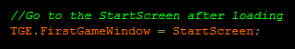
Start & End Screens
All the techniques explored in GameScreen.js can be applied to both the StartScreen.js and EndScreen.js.
Go back to Assets.js and adjust the First Game Window to StartScreen
What else could we add to Smash Bug!?
Notes:
The game is complete!
Let have the game start with the Start Screen.
Many of the elements learned in during the Game Screen can be applied to both the Start and End Screen

Slide 17
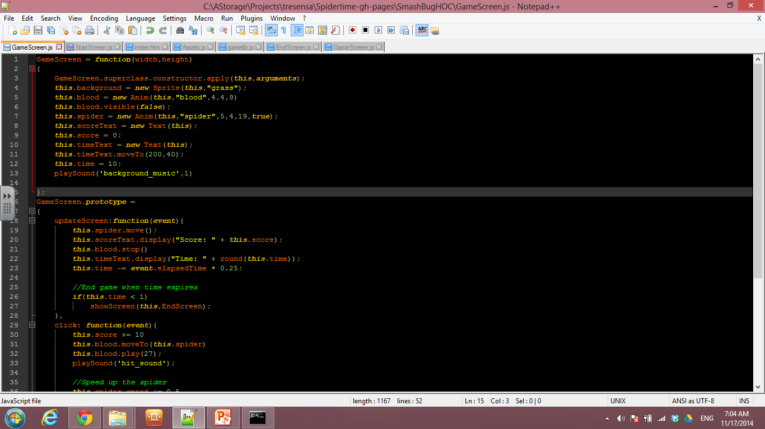
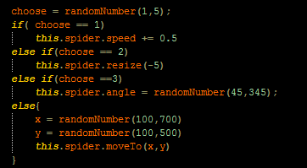
Enhancements
Below are a few examples of enhancements.
1) Add music to the game.
2) Add sound effect when the spider is hit.
3) Make the increased challenges random.
Wow! The options are endless.
Notes:
Here are some additional enhancements that really change the feel of the game.
No game is complete without sound effects.
Add some unpredictability by randomly selecting which increased challenge to apply.

Slide 18

Hour Of Code
Thank you for coming out to learn a little coding and producing some art.
For more information about learning to code visit.
code.org
learn.code.org
Sign up at code.org to show your support that all students should have the opportunity to learn computer science.
Notes:
Thank you for coming.

